Slide 1
CS2040/C
Week 13a, MST + VA OQ Details

Slide 2
Optional Lecture: MST + Prim’s algorithm
https://visualgo.net/en/mst?slide=1 to end, skipping Kruskal’s
Grand tour of the entire CS2040C module (details in Slide Notes)
We just use the e-slides, not really a flipped class for today
See live code on Kattis – cats and the comments there
Notice the similarities of Prim’s and what you have learned before:
The usage of 3 DSes: Priority Queue ADT, Adjacency List graph DS, visited array
The fact that Prim’s grows a spanning tree from a selected source vertex s, similar to DFS, BFS, and SSSP (Dijkstra’s, either version)
The fact that Prim’s is as greedy as Dijkstra’s
The differences: Dijkstra’s greedily select next vertex with smallest distance estimation from source, Prim’s greedily select next edge with smallest weight that is not going to cause a cycle
Notes:
Grand tour: C++ (live code MST), Algorithm Analysis (Analyze Prim’s and Kruskal’s eventually O(E log V)), link sorting for edge list sorting of Kruskal’s, link Prim’s Priority Queue to Binary Heap and/or Balanced BST, link Graph DS (Edge List for Kruskal’s or Adjacency List for Prim’s, kinda List ADT but not a standard list), link DFS/BFS/Dijkstra’s (SSSP) Spanning Trees of various input connected weighted graphs.
Cannot be forced-linked: Stack/Queue/Deque (probably irrelevant for MST), Hash Table (probably also irrelevant for MST).

Slide 3
Admins – VisuAlgo Online Quiz (VA OQ) (1)
It is tomorrow/this Friday (of week 13), during your last lab session
My last speedrun, I can consistently get ~[16-19]/19 in about 10m :O
Warning: the /sssp module contains some stuffs that were only discussed recently
You have 25m and just 1 try for this e-learning semester
Anyone with technical glitch on D-day, have other module presentation clashing with your usual lab slot :O (ME3103, EE2026 :O), official MC/bereavement, etc, or bottom X after tomorrow/this Friday, will be re-invited to do the same setup with Steven on Wed, 18 Nov 2020, 1-1.25pm (1h after re-PE), max involving 25 students only
Max score for such remedial e-VA OQ is up to official class average (B) – see next few slides
Go to https://visualgo.net/training click CS2040/C Quiz at the top, enter your name with e-proctoring specific PREFIX substring (thus you need to be present at your last e-Lab session), Lab TAs will start 4 students at a time with about ~1+m interval (so not ALL ends at exactly the same time even if everyone maximizes 25m)
There is NO manually graded questions
Your Lab TA will focus on e-proctoring you rather than doing this extra challenge

Slide 4
Admins – VisuAlgo Online Quiz (VA OQ) (2)
E-environment setup:
Maximize (but not full screen) mode (show your task bar especially SYSTEM DATE+CLOCK),
No other browser tab,
Cannot switch window,
No discussion,
Lab TA will invigilate (e-Proctor via Zoom – showing you doing VA OQ on screen – that is recorded),
Do self recording for insurance again (will be randomly required for at least X out of Y students per lab – Steven will email those students to upload their ~25+buffer minutes *.mp4 recording to LumiNUS files)
Open book, but NOT OPEN INTERNET (especially cannot open other VisuAlgo tabs)
Suggested material to use: Transparent plastic + marker over your own screen :O, various compiled tips and tricks for Online Quiz (list of modulos, list of Catalan numbers :O, etc).
I allow physical calculator (don’t use JavaScript console or any calculator app on screen)

Slide 5
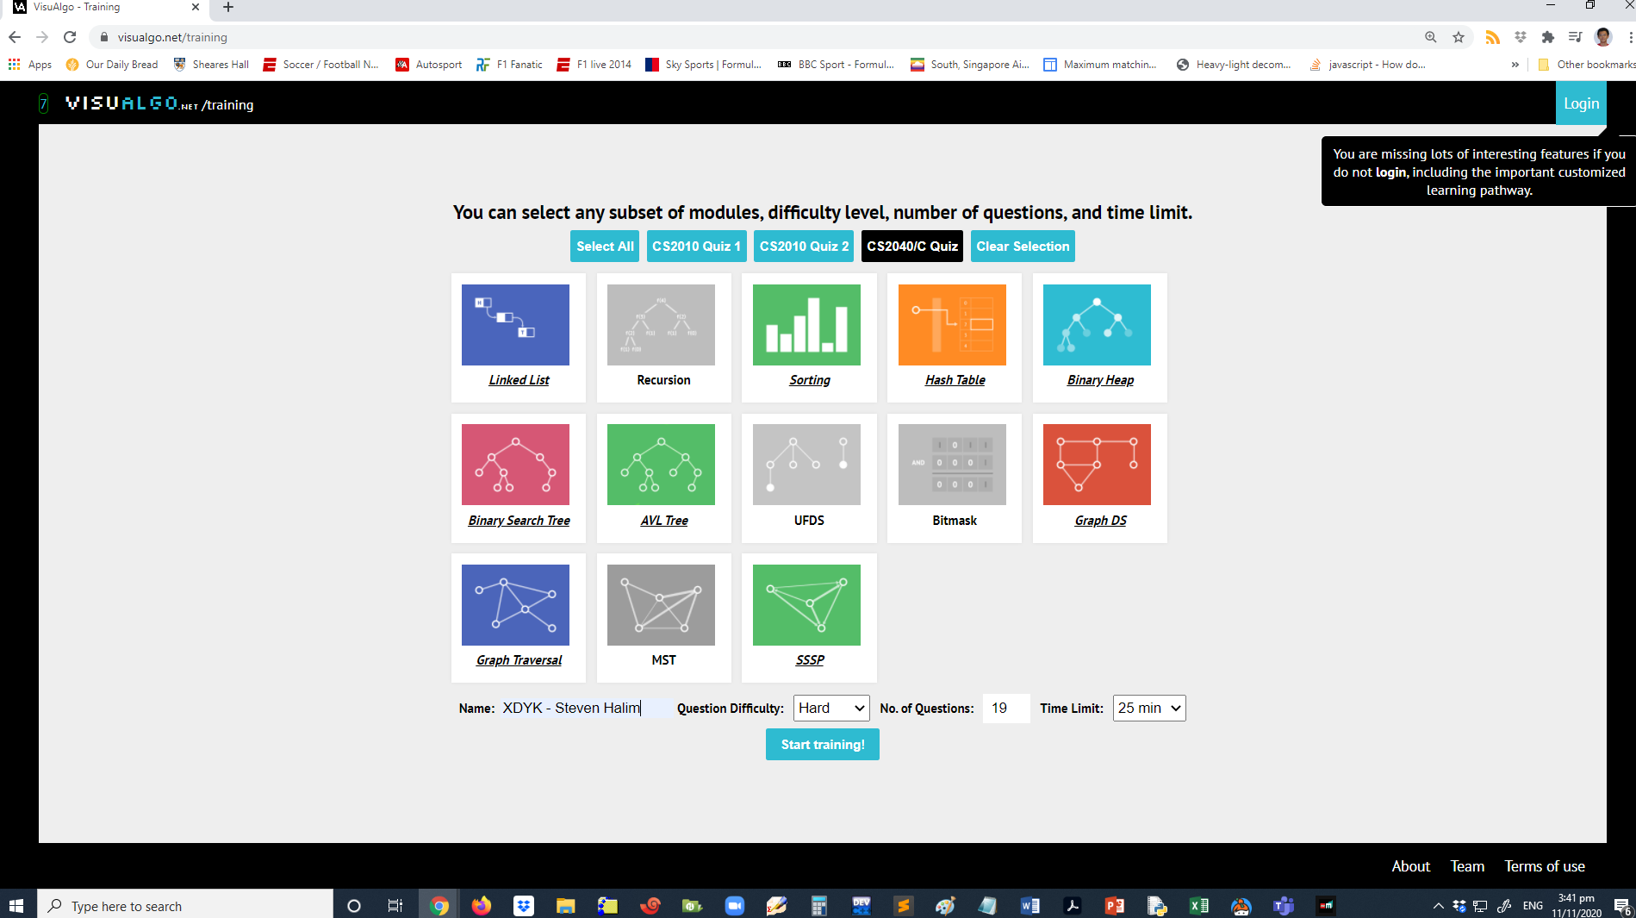
Example Recording + Initial Setup
Your Lab TA will release about ~4 students (2x2 Zoom screen) in a go
This part must be visible in your recording, especially the name prefix

Slide 6
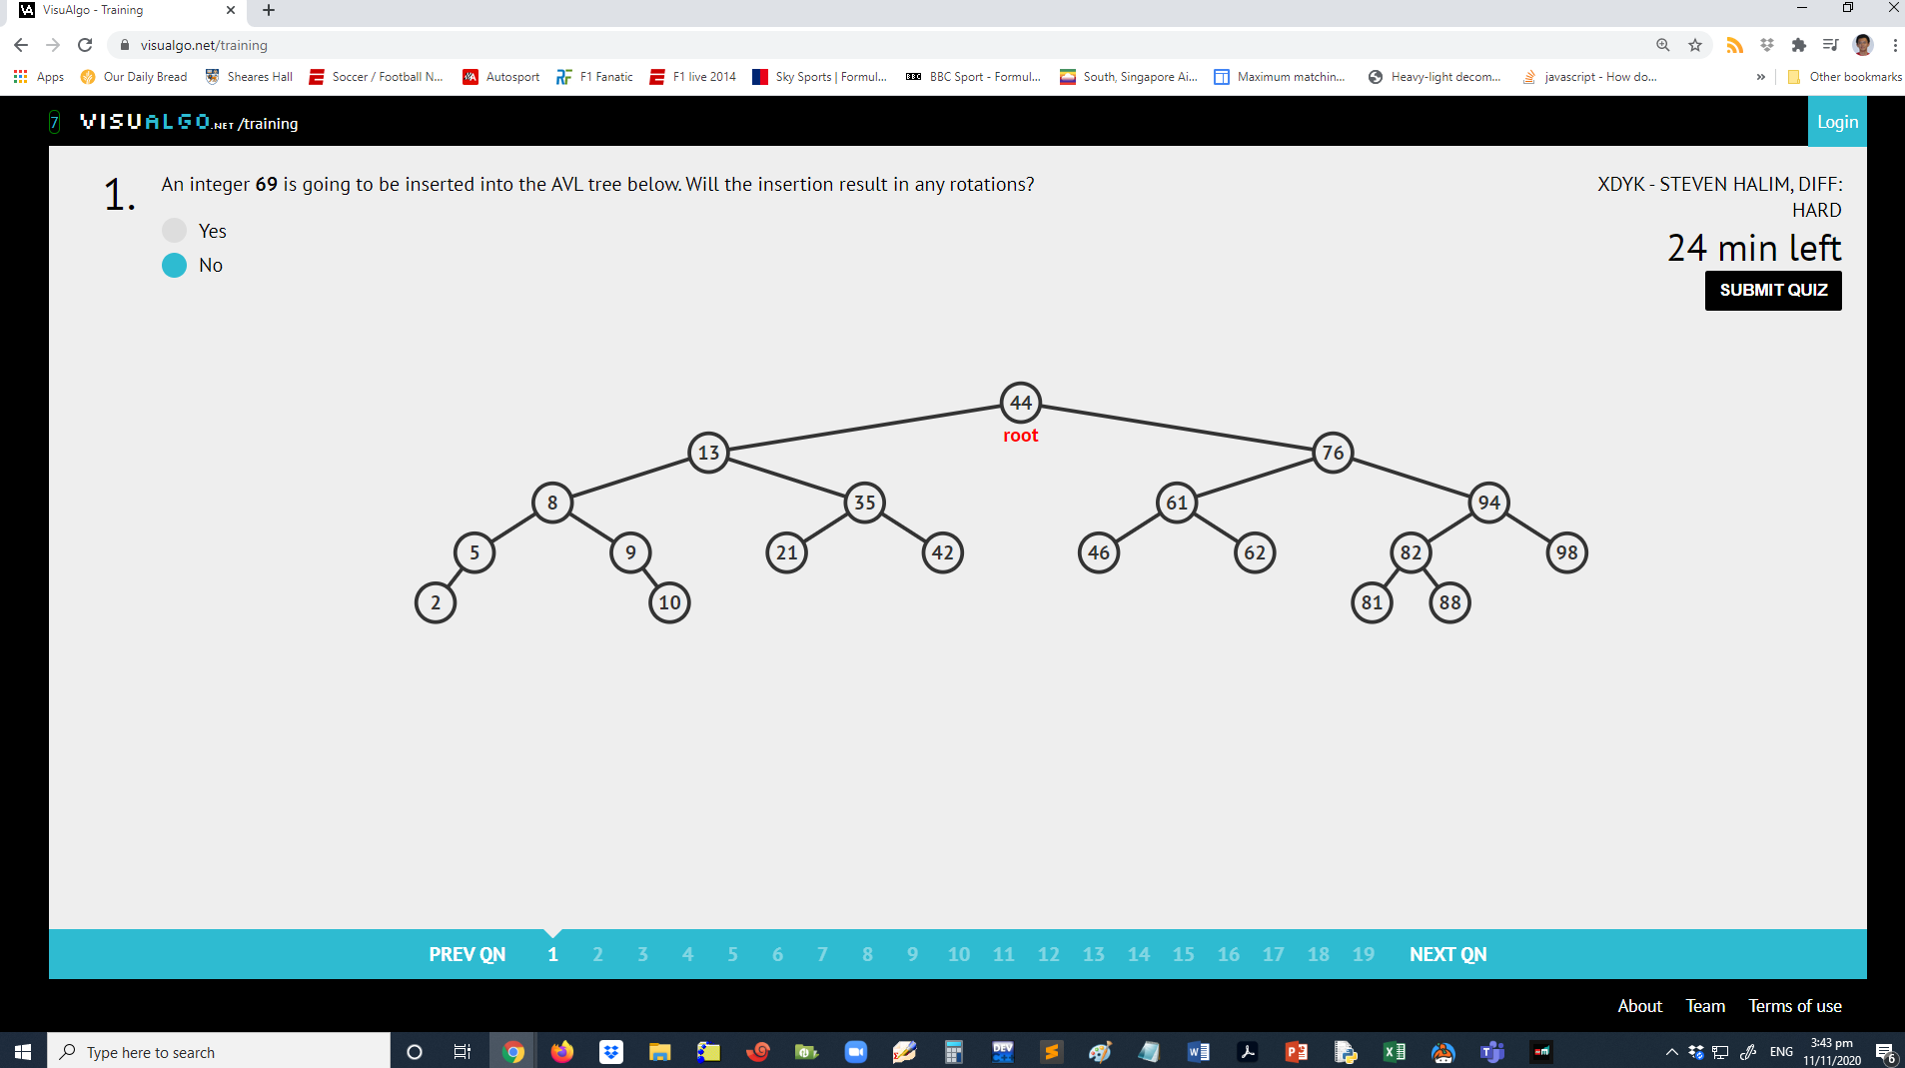
Example Recording + The Execution
The countdown timer (must go down) and system time (must go up) must all tally in your recording

Slide 7
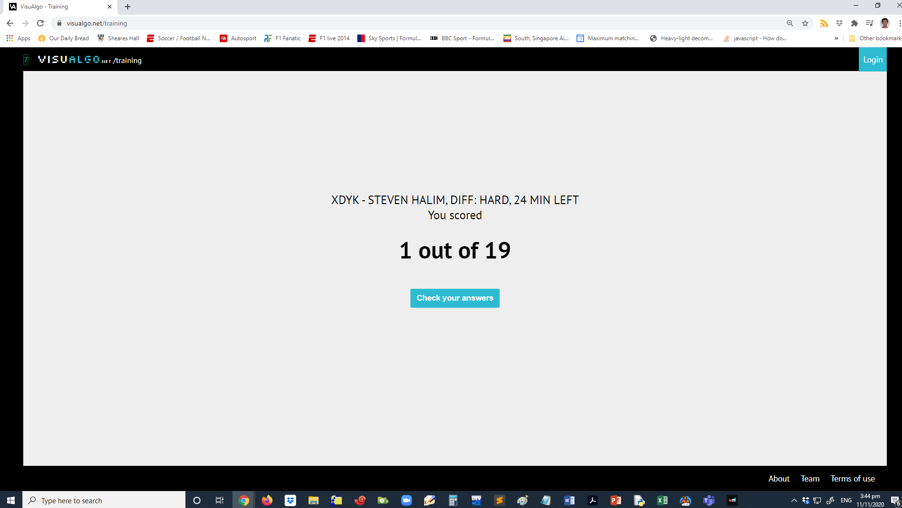
Example Recording + Final Screenshot
When you are (about to) done, ask your TA to see this final screen and record the result
Transition from clicking “Submit Training” (or when time is up) to this screen MUST BE in your recording and all system time matches

Slide 8
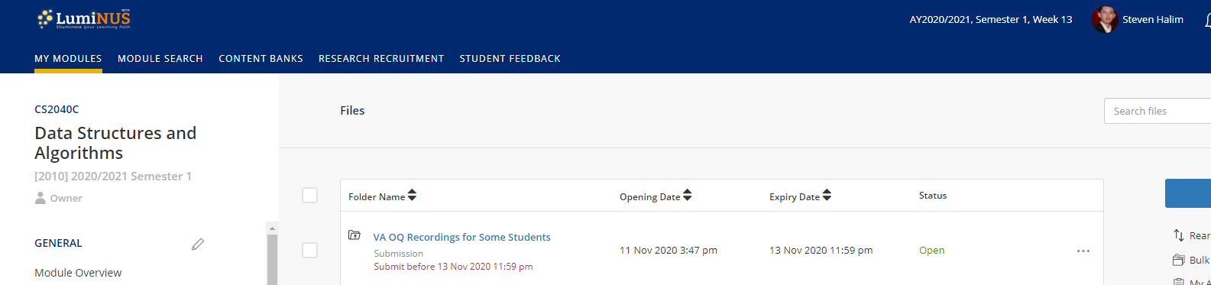
Uploading the Recording
If you receive special email from Steven on Wed, 11 Nov, around 4-5pm ish, it means that Steven is *interested* to see your recordings in much more detail because of *certain stuffs*
These students should upload their ~25m+buffer mp4 recording to LumiNUS Files no later than 4 hours from their Lab session time

Slide 9
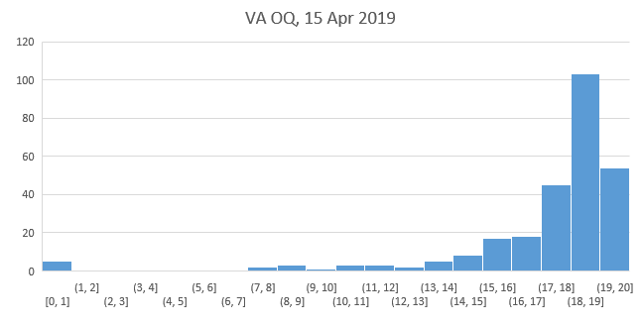
Previous Stats
Typical VA OQ statistics was like this, and this should be your aim too tomorrow/by Friday, this is indeed the easiest 15% of this module, failing which is almost guarantee failing the entire module :O
B for this screenshot is floor (18+) = 18/20
Expected B for single run out of 19 VA OQ questions only is floor (17+) = 17/19

